Slide 1
Sport Video Analytics and Retrieval
Team3
Zeshan Ather
John Goza
Hongkun Jin
Mouqing Jin
Notes:
1

Slide 2
Proposed Work
Generate Various models for Image Classification using Decision Trees, Random Forests.
Build a Convolutional Neural Net for Image Classification.
Using Spark API/Clarifai API to create a simple Android Application for sports information.

Slide 3
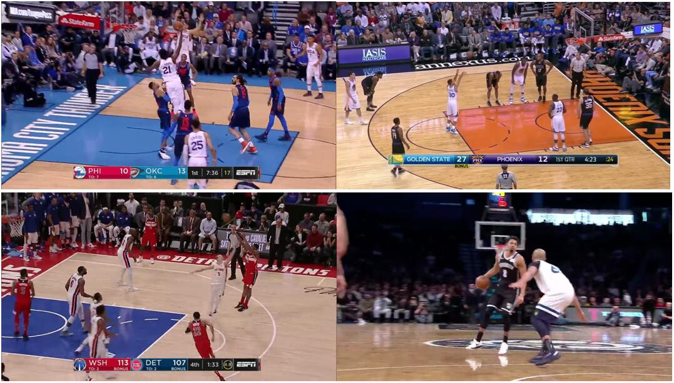
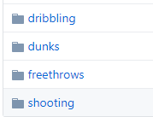
Data Collection
Generated about 200 frames images divided into 4 categories from different basketball videos. The 4 classes are:

Slide 4
Architecture
Users
Spark: trained the video and did the objection detection from Keyframes. Image classification task with the algorithms (e.g., Decision Tree, Random Forest, Naïve Bayes).
Clarifai: Put images to the Clarifai service and returns a prediction.
Tensorflow: Image Classification Task with CNN, Linear Regression, and SoftMax Regression.
Android App
Machine learning (Spark)
External API (Clarifai)
Deep Learning (TensorFlow)

Slide 5
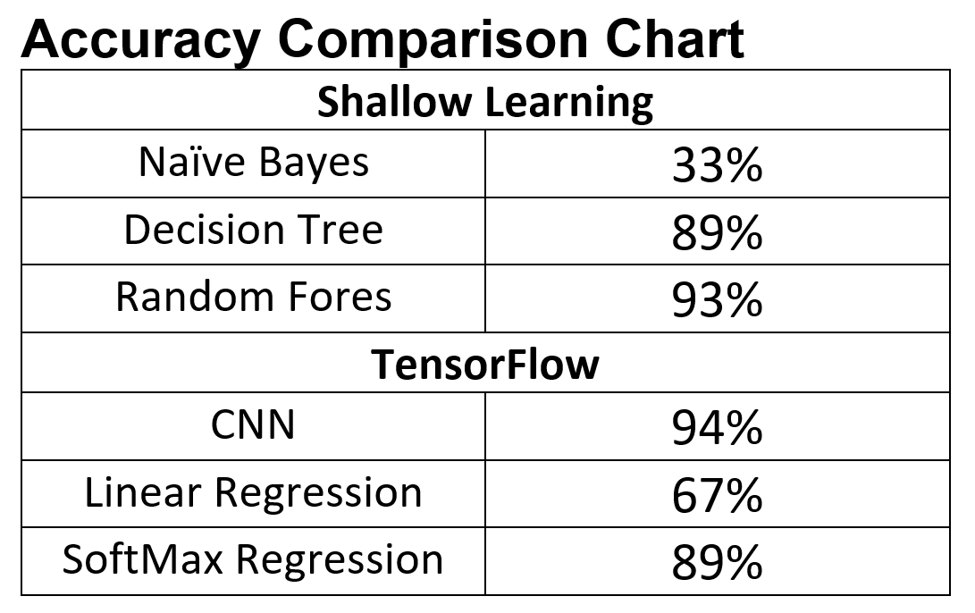
Results
Inception : 95.3%

Slide 6
Results (Clarifai)
Categories | Accuracy %
Dribble | 96
Dunk | 96
Shooting | 83
Free Throws | 99
Total | 94

Slide 7
Android Application
External API (Clarifai)
Request(image)
Model trained using decision tree
Response(Prediction)
Model trained using random tree
Model trained using Inception model

Slide 8
Thanks

